Slide 1
2012 Indiana Bee Kill Investigations: Sampling and Detecting Pesticide Residues in Bees and Pollen
2013 TPSA Annual Meeting
Mobile, Alabama
Dave Scott and Kevin Neal
Office of Indiana State Chemist

Slide 2
Summary of Bee Mortality Cases
April to May 2012, seven cases investigated
All reported large quantities of bees dying/dead (hundreds)
Complainants (beekeepers) suspected the bee deaths were in response to either pesticide application or corn planting in neighboring fields.
Dead bees and in some cases, bee pollen and vegetation from the target fields were sampled and tested for pesticide residue.

Slide 3
Sample # | Sample Description | PPB Clothianidin
2012-0093 | Dead and dying bees (collected by the beekeeper) | 7.0
2012-0094 | Dead and dying bees (collected by OISC investigator) | 3.4
2012-0106 | Dead and dying bees (drunk-like) | 3.5
2012-0131 | Pollen | >7.4
2012-0132 | Pollen | >8.1
2012-0133 | Dead bees | >4.8
2012-0134 | Dandelions from adjacent farm field | >6
2012-0120 | Dead and dying bees (spasms, could not fly) (collected by the OISC investigator) | 2.5
2012-0121 | Dead and dying bees (collected by the beekeeper) | 3.1
2012-0178 | Dead and dying bees | 3.3
2012-0174 | Dead bees from 22 hives | 2.5
2012-0199 | Dead bees (large bee kill, > 200 hives impacted) | 80.0
2012-0197 | 2x2 swab outside of bee box | 20.3 ng/swab

Slide 4
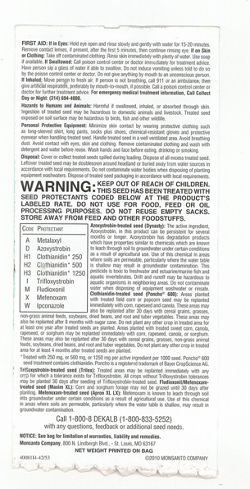
Notes:
Treated seed label submitted by the farmer.

Slide 6
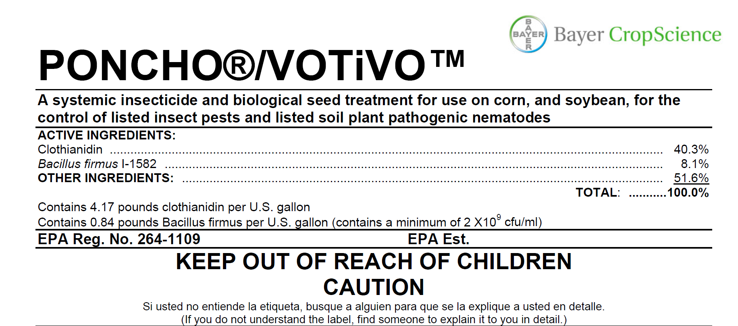

Slide 7
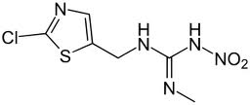
Clothianidin
A neonicotinoid
Nature, Oct. 2012 Study of Combined pesticide exposure severely affects individual- and colony-level traits in bees: neonicotinoid and pyrethroid
European Food Safety Authority: EFSA Journal 2013;11(1):3066, Conclusion on the peer review of the pesticide risk assessment for bees for the active substance clothianidin

Slide 8
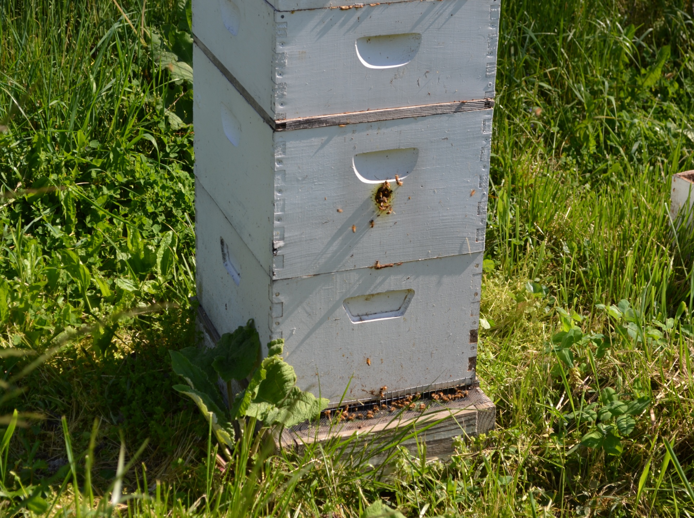
Case 12-0737
2.5 ppb clothianidin found on dead bees

Slide 9
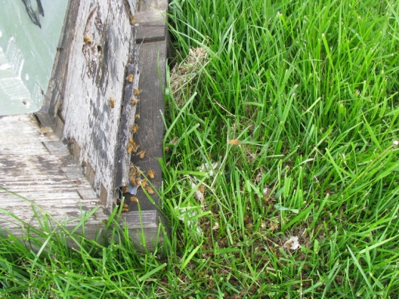
Case 12-0700 picture 1
3 ppb clothianidin found on dead bees
Notes:
Farmer (half mile away) started planting on 4/18. On the same day, bee keeper observed:
Odd bee behavior
2. Bees disoriented and sluggish
3. Bee had spasms and could not fly
Dead bees in the hundreds range in one day
Two bee samples collected: 2.5 ppb and 3.1 ppb clothianidin found

Slide 10
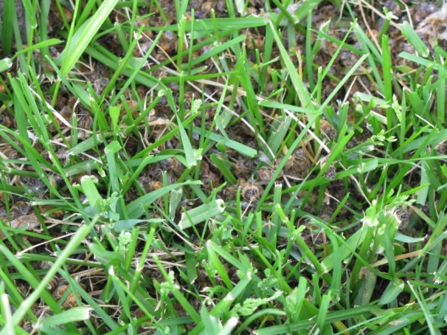
Case 12-0700 Picture 2

Slide 11
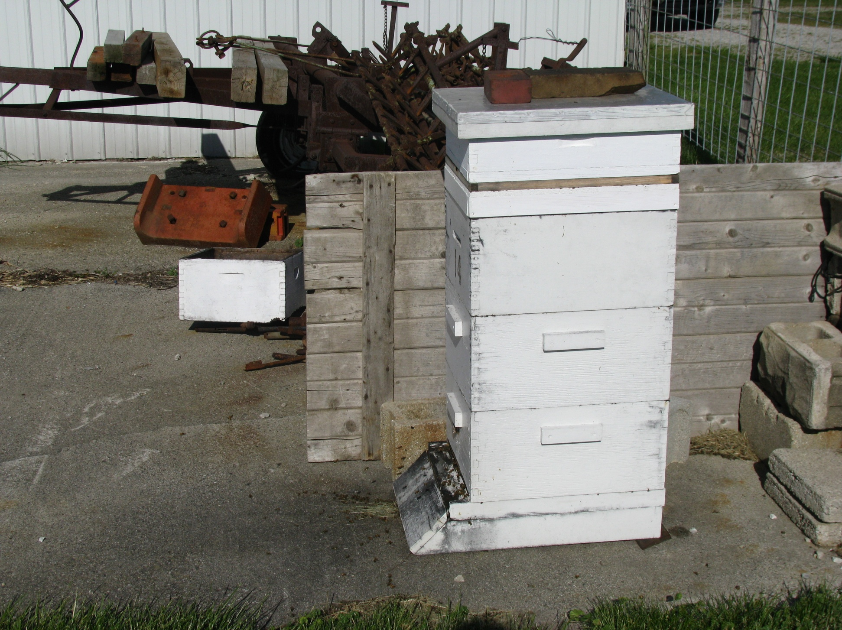
Case 12-0698 Picture 1
Notes:
Pollen and dead bees were collected: confirmed with chlothianidin 5-8 ppb.
Dandelions from the target farming area which had the Poncho 600 seed application was confirmed with chlothianidin 6 ppb.

Slide 12
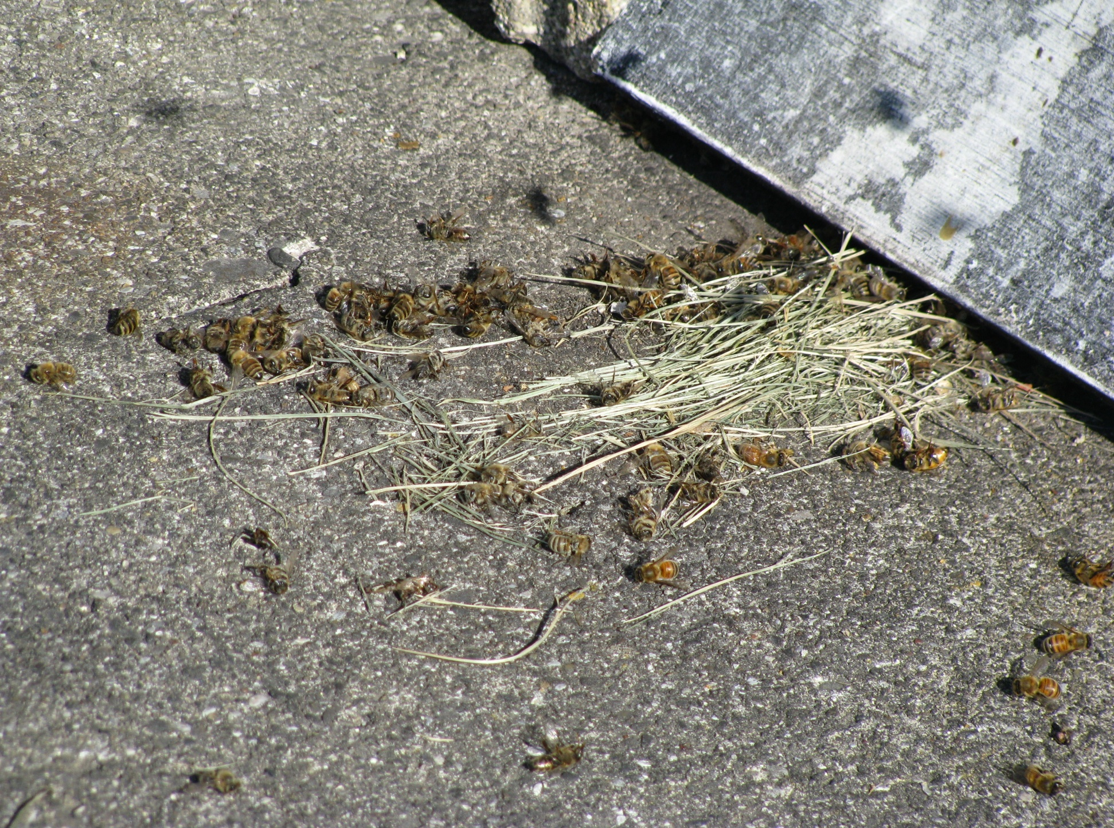
Case 12-0698 picture 2

Slide 13
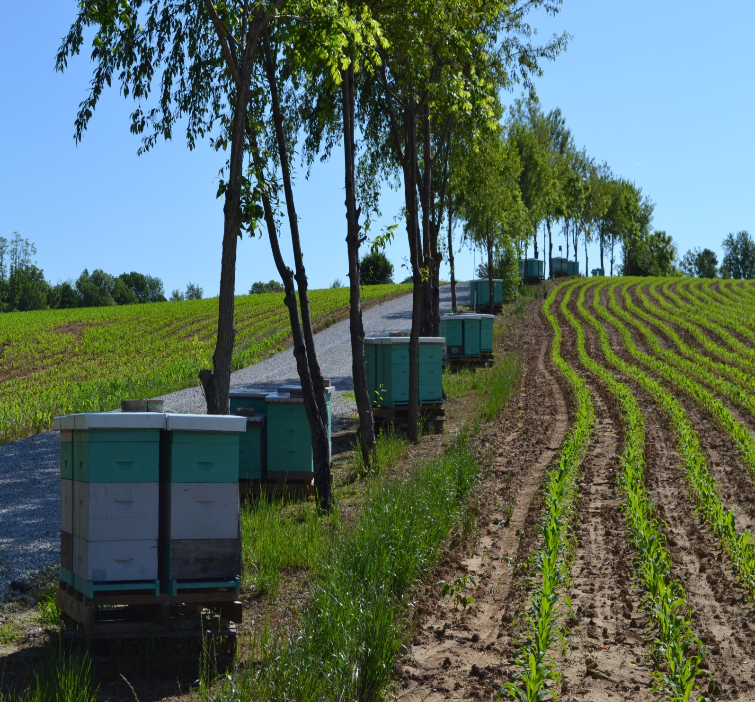
Case 12-0756 Picture 1
Notes:
Large bee operation, more than 200 hives impacted.
Several hives showed complete colony death, with dead bees both inside and outside of the hive boxes.

Slide 14
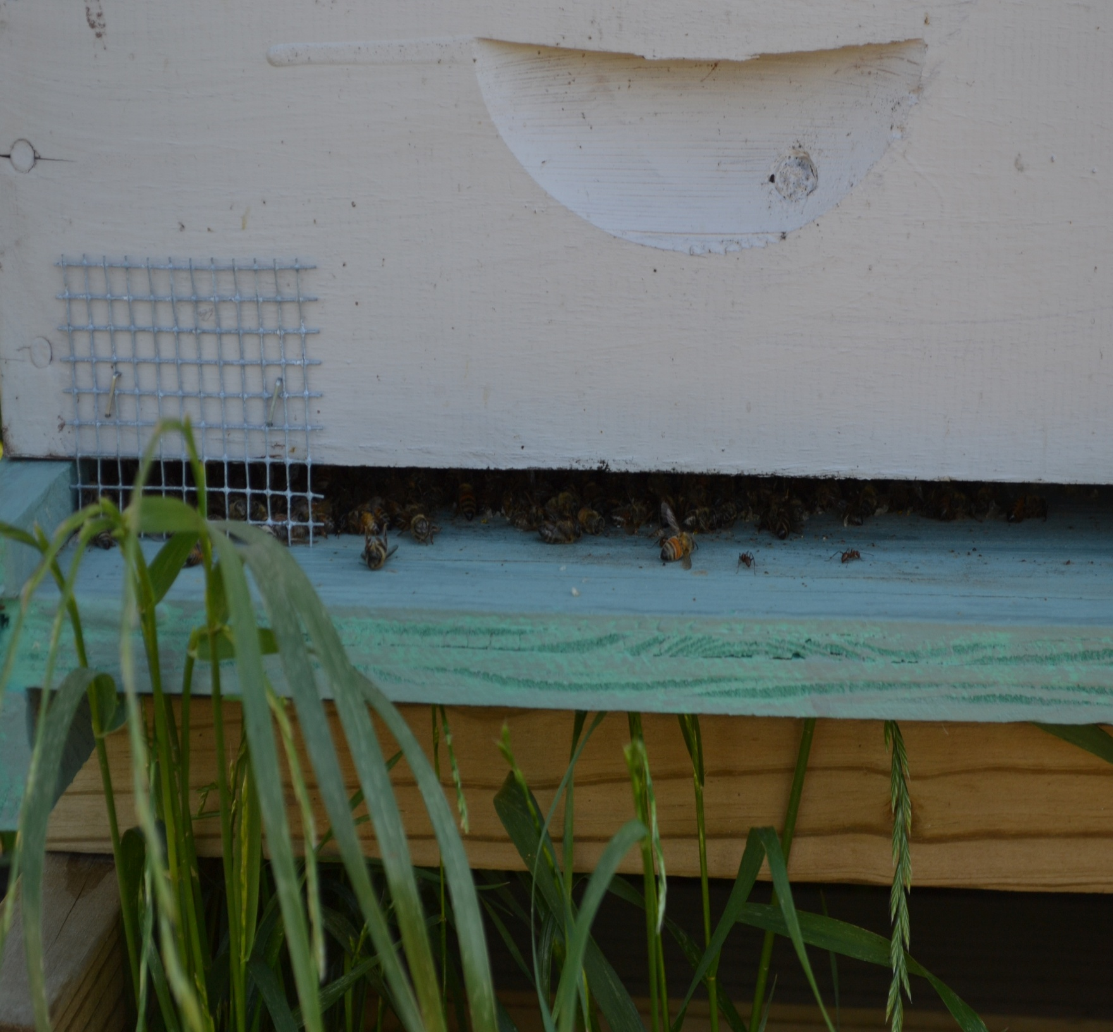
Case 12-0756 Picture 2
Notes:
Clothianidin = 80 ppb in dead bees

Slide 15
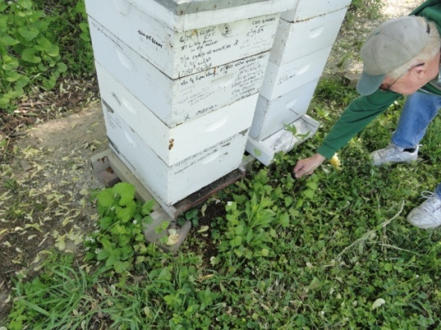
Case 0658 Picture 1

Slide 16
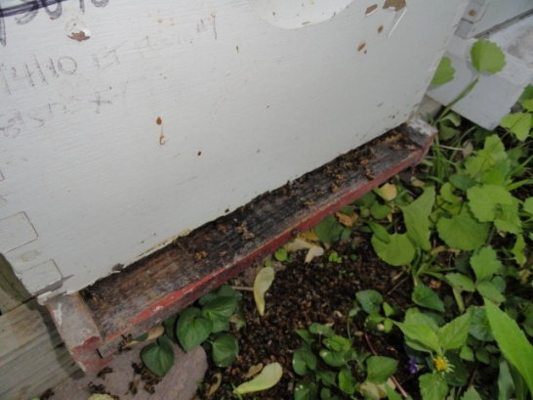
Case 0658 Picture 2
Notes:
3.4 ppb and 7 ppb for two dead bee scoops collected on different dates.
After corn planting with treated seeds, bee keeper reported large quantities of dying/dead bees (hundreds)

Slide 17
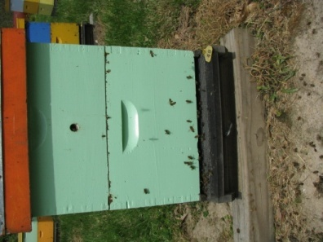
Case 0693
Notes:
Purdue Bee Lab reported large quantities of bee death on 4/16. Drunk-like behavior from bees. Some already dead, some were dying.
3.5 ppb clothianidin found.

Slide 18
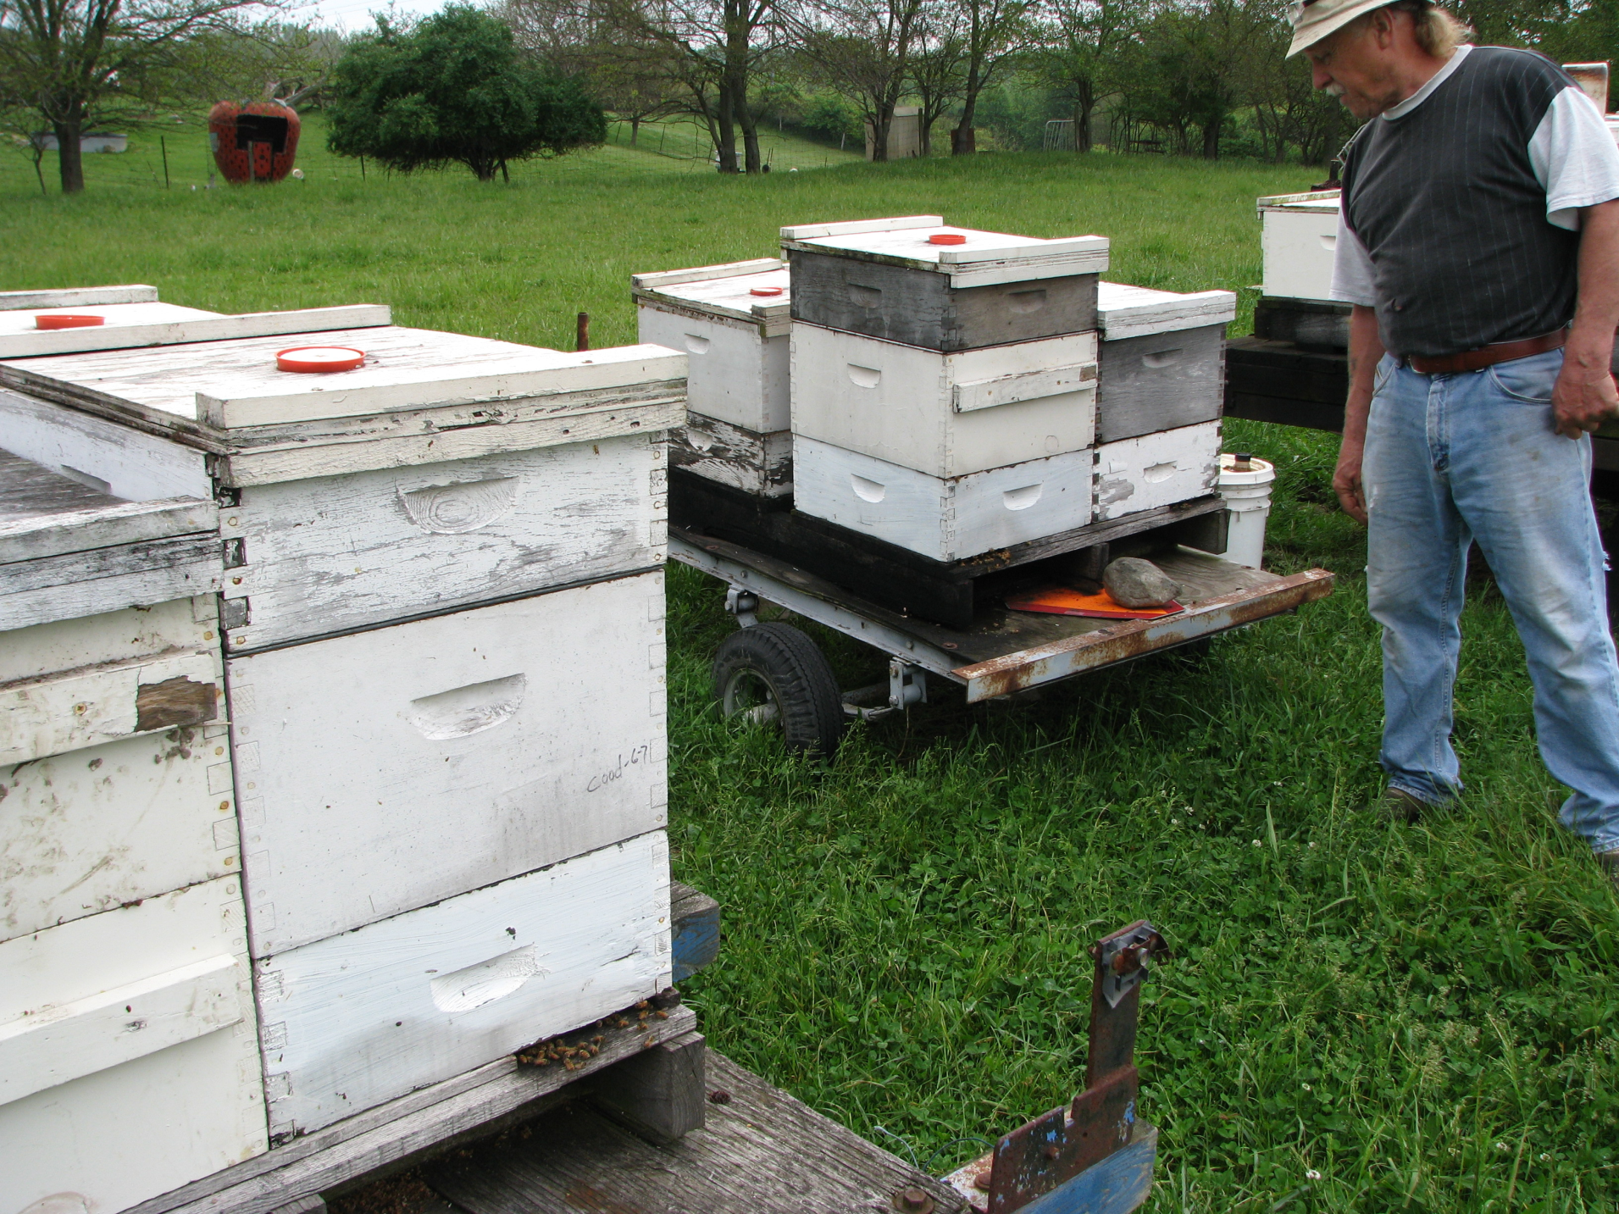
Case 0733 Picture 1

Slide 19
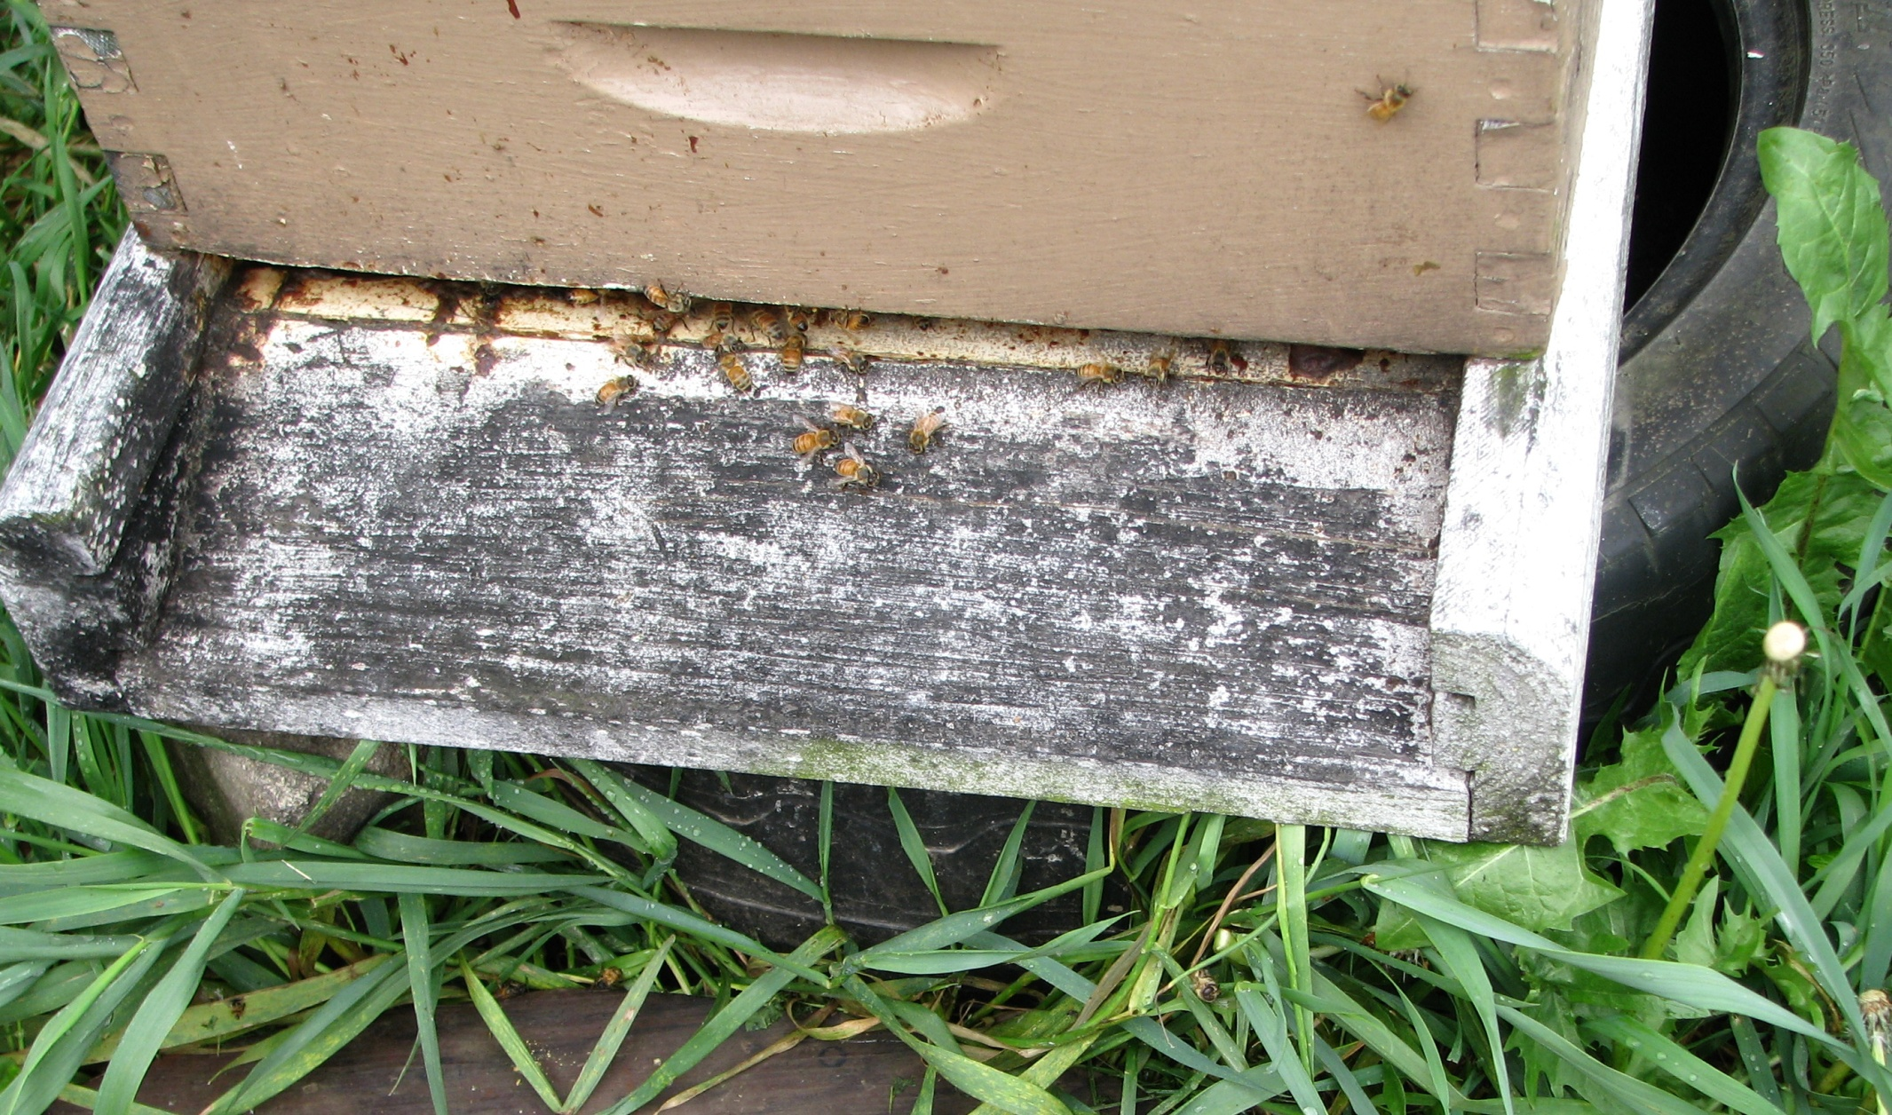
Case 0733 Picture 2
Notes:
May 1st, 2012: The beekeeper told me that the live bees were pushing the dead bees out of the hive. They were falling into tall grass and were not easily
collected, so he placed plywood under the hive so he could better collect them. Unfortunately, the live bees then began pushing the dead bees off the plywood.
He collected to baggies of dead bees and put them in the freezer. When I arrived on a Monday morning, he gave me the bees and showed me his hives…one was
near his barn and the others were on trailers out in his pasture. As I said, he indicated he had no idea where to start looking for applicators since there are many farmers
who had planted corn within 2 miles of his property.
3.3 ppb clothianidin found

Slide 20
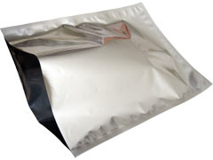
Field Sampling
How many bees? collect (or have bee keeper collect) sufficient amount (1 pint per agency/dept.)
Mylar bags are good for storing dead bees. Glass jars are preferred for pollen and wax materials.
Collect foliage/vegetation or soil samples?
Transfer samples on ice and freeze as soon as samples arrive in lab.
Information about pesticide applications (i.e. corn planting)
What crops are planted
What kinds of seed treatment?
planting date?
planter box cleanout performed?

Slide 21
Analytical Method
“Refined methodology for the determination of neonicotinoid pesticides and their metabolites in honey bees and bee products by liquid chromatography-tandem mass spectrometry (LC-MS/MS)” J. Ag. Food Chem. 2010, 58(10):5926-31
UCT application note: QuEChERS Analysis of Miticides and Other Agrochemicals in Honey Bees, Wax or Pollen

Slide 22
Bee Extraction by QuEChERS
3 g Bees (ground with dry ice)
+
12 mL H₂O and 15 mL 1% HOAC in Acetonitrile
Transfer 1.5 mL Supernatant
to
2 mL Cleanup tube (MgSO₄/PSA/endcapped C18)
Vortex mix 1 minute
+
QuEChERS salt packet (MgSO₄/NaOAc)
Vortex mix 1 min
then
Centrifuge 8000 rpm for 5 min
Shake for 30 min
Centrifuge
4000 rpm for 15 min
Dilute supernatant 1:1 with water
analyze
LC/MS/MS
“Refined methodology for the determination of neonicotinoid pesticides and their metabolites in honey bees and bee products by liquid chromatography-tandem mass spectrometry (LC-MS/MS)” J. Ag. Food Chem. 2010, 58(10):5926-31
Notes:
A bee weighs about 1/10 of a gram. 3 gram bees= 30 bees
The QuEChERS method has been widely accepted by many pesticide residue analysts since 2004.
QuEChERS stands for the “Quick, Easy, Cheap, Effective, Rugged, and Safe” approach to pesticide residue analysis.

Slide 23
Wax Extraction by modified QuEChERS method
3 g wax (ground with dry ice)
+
12 mL H₂O and 15 mL 1% HOAC in Acetonitrile
Shake for 30 min and Centrifuge at 4000 rpm for 15 min
Melt wax at 80 °C water bath
then
cool to room temp
Transfer 1.5 mL Supernatant
to
2 mL Cleanup tube (MgSO₄/PSA/endcapped C18)
Vortex mix 1 minute
+
QuEChERS salt packet (MgSO₄/NaOAc)
Vortex 1 min,
Centrifuge 8000 rpm for 5 min
Dilute supernatant 1:1 with water
analyze by LC/MS/MS
“Refined methodology for the determination of neonicotinoid pesticides and their metabolites in honey bees and bee products by liquid chromatography-tandem mass spectrometry (LC-MS/MS)” J. Ag. Food Chem. 2010, 58(10):5926-31

Slide 24
Method Performance
Linearity R² > 0.99
Limit of Detection = 0.5 ppb
Limit of Quantitation = 1.5 ppb
Clothianidin Recovery = 55-75%

Slide 25
Conclusions
Clothianidin was detected in bees and pollens.
No violation of the Indiana Use of Application Law could be documented.

